Slide 1
RESTful Web Services
Dr David Wyatt

Slide 2
Session Plan
Hypertext Transfer Protocol (HTTP)
HTTP Request Methods
HTTP Response Codes
RESTful Services
  Motivation for REST
  REST Principles
  REST Design Pattern
CRUD/HTTP Mapping
Fundamental Aspects of the REST
Characteristics of REST
Using URL’s to Name Resources
Using HTTP Request methods
Case study
REST and SOAP

Slide 3
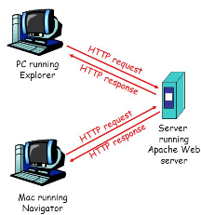
Hypertext Transfer Protocol (HTTP/S)
The protocol that drives the web, runs on top of TCP/IP
  simple, stateless, request/response protocol
  allows clients (e.g. web browsers) to send requests to web servers
  for web pages, images, music, videos
  JSON data, XML data etc.
  it is connectionless as
    each request makes a new connection to the server
Resources accessed by HTTP are identified by URIs (more specifically URLs), using the HTTP URI schemes.

Slide 4
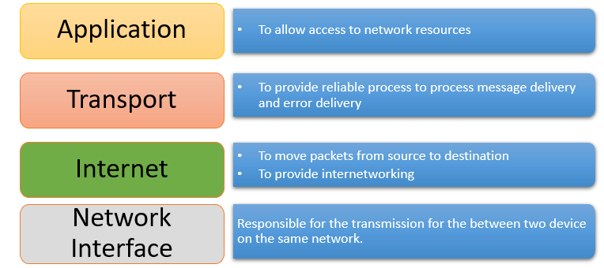
Four Layers of Transmission Control Protocol/ Internet Protocol (TCP/IP)

Slide 5
HTTP Request Methods
Method | Description | Idempotent? | Safe?
GET | Requests data (web pages are data) | Yes | Yes
HEAD | Requests header info | Yes | Yes
POST | Used to submit data to a server | Usually No | No
PUT | Replace/update the data on a server | Yes | No
PATCH | Partially update some data on a server | Not Guaranteed | No
DELETE | Used to delete some data on a server | Yes | No
TRACE | Performs a message loop-back test along the path to the target | Yes | Yes
*idempotent (幂等的) – repeated usage does not change the final state beyond the first request
*safe (安全的) – it does not change anything

Slide 6
Common REST HTTP Response Codes
Type |  | Code | Meaning
2XX | Successful | 200 OK | Request succeeded
 |  | 201 Created | New resource created
 |  | 204 No Content | Success, no body returned
4XX | Client Error | 400 Bad Request | Invalid request
 |  | 401 Unauthorized | Authentication required/failed
 |  | 403 Forbidden | Request understood but not allowed
 |  | 404 Not Found | Resource does not exist
 |  | 409 Conflict | Request conflicts with current state
5XX | Server Error | 500 Internal Server Error | Server-side failure
 |  | 503 Service Unavailable | Service temporarily unavailable

Slide 7
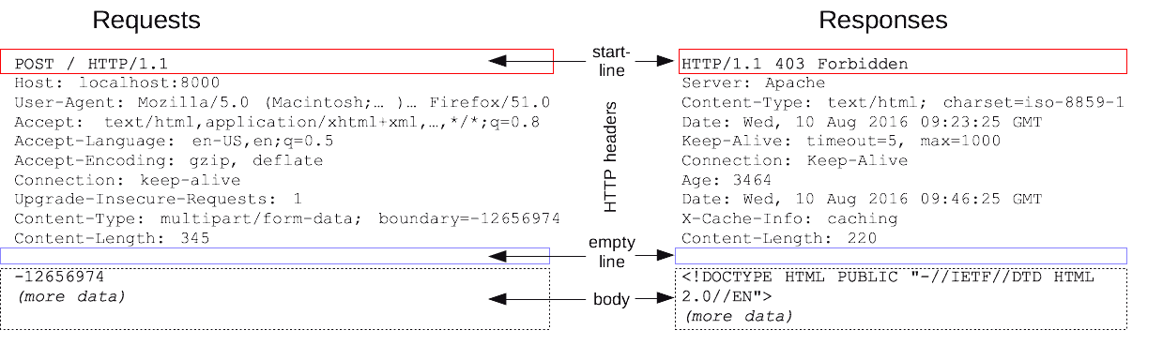
Sample Request & Respond

Slide 8
RESTful Services
Representational State Transfer
A simplified approach to web-based interactions
"REST" was coined by Roy Fielding in his PhD Thesis
  to describe a design pattern for implementing networked systems.
  Fielding – one of the principal authors of HTTP
  Used REST to describe the architectural pattern of the web

Slide 9
Motivation for REST
Representational
State
Transfer
Aimed to create a design pattern to describe the interactions within the Web
But with an eye to Web Services and other potential communication frameworks
Really a set of principles for how resources are defined and used
  resources are things which provide information
Systems which follow these principles are termed RESTful

Slide 10
REST Principles
Application state and functionality are abstracted into resources
Every resource is uniquely addressable (using a URI)
  Using a standardized syntax with a common interface
    Via a constrained set of defined operations
    A constrained set of content types (e.g., JSON, XML, text)
    Data-centric not functionality centric
  A simple vocabulary for indexing information etc.
  Via http methods
Via a protocol which is stateless, client-server oriented

Slide 11
REST Design Pattern
All interactions between a client and a web service are done with simple operations
Most web interactions are done using http and just four operations:
  Retrieve information (HTTP GET)
  Create information (HTTP POST)
  Update information (HTTP PUT)
  Delete information (HTTP DELETE)
Plus
  What HTTP methods are supported (HTTP OPTIONS)
  Meta-information about the resource (HTTP HEAD)

Slide 12
CRUD/HTTP Mapping
CRUD Task | HTTP Method | Action
Create | POST | Create a resource (without an ID)
Read | GET | Read a resource (no side effects, possibly cached)
Update | PUT | Update (or possibly create) a resource with an ID
Delete | DELETE | Delete a resource

Slide 13
The Three Fundamental Aspects of the REST Design Pattern
Resources
  Every distinguishable entity is a resource. e.g., a JSON document, a Web service,
URIs Identify Resources
  Every resource is uniquely identified by a URI.
Simple Operations
  Create, Read, Update, Delete (CRUD)
Resources
URIs
Simple
Operations
Notes:
URL- Uniform Resource Locator

Slide 14
The six characteristics of REST:
Uniform interface
  resources are accessed in a consistent way, typically using standard HTTP methods such as GET, POST, PUT and DELETE
Decoupled client-server interaction
  client and server have separate responsibilities; the client handles the user interface while the server handles data and business logic
Stateless
  each request must contain all the information needed to process it; the server does not keep client session state between requests
Cacheable
  responses should indicate whether they can be cached, helping reduce repeated requests and improve performance.
Layered
  a client does not need to know whether it is communicating directly with the server or through intermediaries such as proxies, gateways or load balancers
Code on demand (optional)
  the server may send executable code to the client, such as JavaScript, to extend client functionality.
* Services that do not conform to the above-required constraints are not strictly RESTful web services.

Slide 15
Using URIs to Name Resources
Customers
  http://bookshop.com/customers
Orders
  http://bookshop.com/orders/
Customer with id 1234
  http://bookshop.com/customers/1234
Order with id 5678
  http://bookshop.com/orders/5678
Orders for customer with id 1234
  http://bookshop.com/customers/1234/orders
List of all customers with the last name of more
  http://bookshop.com/customers?last-name=moore

Slide 16
Resource vs Representation
REST transfers representations of resources — not the resources themselves.
Resource
  The actual thing being identified.
  Has a unique URI.
  Example: customer 1234.
Representation
  The data sent to describe the current state of that resource.
  Can be formatted as JSON, XML, etc.
Example:
    {
    "id": 1234,
    "name": "Alice Smith",
    "email": alice@example.com
    }
  GET /customers/1234 means “Give me a representation of customer 1234.”
    The resource is the customer.
    The JSON is one kind of representation of that customer – it could be represented in XML or some other format (HTML, CSV, etc).

Slide 17
Using HTTP Request methods
Method | URL | Purpose
GET | http://bookshop.com/customers | Retrieve all customers
GET | http://bookshop.com/customers/1234 | Retrieve customer 1234 details
POST | http://bookshop.com/customers | Create new customer; details in body of request
PUT | http://bookshop.com/customers/1234 | update an existing customer (1234); details in body of request
DELETE | http://bookshop.com/customers/1234 | delete customer 1234

Slide 18
A typical HTTP REST URL:
A URL is a type of URI that also tells us where the resource is located.
The protocol identifies the transport scheme that will be used to process and respond to the request.
The hostname identifies the server address of the resource.
The path and query string can be used to identify and customize the accessed resource.
http://my.store.com/fruits/list?category=fruit&limit=20
protocol
host name
path to a resource
query string

Slide 19
Approach 1 "Press 1 for Premier, Press 2 for…"
The airline provides a single telephone number.
Upon entry into the system a customer encounters an automated message, "Press 1 if you are a premier member, press 2 if you are a frequent flyer, press 3 for all others."
Premier
Customer
Representative
Answering
Machine
F.F.
Customer
Representative
Airline Reservations
Regular
Customer
Representative

Slide 20
Approach 2 Telephone Numbers are Cheap!
The airline provides several telephone numbers:
e.g., One number for premier members, a different number for frequent flyers, and still another for regular customers.
Premier
Customer
Representative
1-800-Premier
Premier Members
F.F.
Customer
Representative
1-800-Frequent
Frequent Flyer Members
Regular
Customer
Representative
1-800-Reservation
Regular Members

Slide 21
Discussion
Premier
Customer
Representative
1-800-Premier
Premier
Customer
Representative
Premier Members
Airline Reservations
Answering
Machine
F.F.
Customer
Representative
1-800-Frequent
F.F.
Customer
Representative
1-800-Reservation
Regular
Customer
Representative
Regular
Customer
Representative
Regular Members
In Approach 1 the answering machine introduces an extra delay, which is particularly annoying to premier members.
With Approach 2 there is no intermediate step. Premier members get an instant pickup from a customer service representative. Others may have to wait for an operator.

Slide 22
Web-Based Reservation Service
Suppose now the airline wants to provide a Web reservation service for customers to make flight reservations through the Web.
Just as with the telephone service, the airline wants to ensure that its premier members get immediate service, its frequent flyer members get expedited service, and all others get regular service.
There are two main approaches to implementing the Web reservation service. The approaches are analogous to the telephone service...

Slide 23
Approach 1 One-Stop Shopping
The airline provides a single URL. The Web service is responsible for examining incoming client requests to determine their priority and process them accordingly.
client
Premier Members
Premier
Customer
Web
Reservation
Service
Determine
Priority
F.F.
Customer
client
Frequent Flyer Members
Regular
Customer
client

Slide 24
Approach 1 Disadvantages
There is currently no industry-accepted practice (rules) for expressing priorities, so rules would need to be made. The clients must learn the rule, and the Web service application must be written to understand the rule.
This approach is based upon the incorrect assumption that a URL is "expensive" and that their use must be rationed.
The Web service is a central point of failure. It is a bottleneck. Load balancing is a challenge.
It violates Tim Berners-Lee Web Design, Axiom 0

Slide 25
Web Design, Axiom 0 (Tim Berners-Lee, director of W3C)
Axiom 0: all resources on the Web must be uniquely identified with a URI.
URL1
resource1
URL2
resource2
URL3
resource3

Slide 26
Approach 2: URLs are Cheap! Use Them!
The airline provides several URLs - one URL for premier members, a different URL for frequent flyers, and still another for regular customers.
Premier
Member
Reservation
Service
http://www.kings-air/reservations/premier
client
Premier Members
Frequent
Flyer
Reservation
Service
http://www.kings-air/reservations/frequent-flyer
client
Frequent Flyer Members
Regular
Member
Reservation
Service
http://www.kings-air/reservations/regular
client

Slide 27
Approach 2 Advantages
The different URLs are discoverable by search engines and UDDI registries.
It's easy to understand what each service does simply by examining the URL, i.e., it exploits the Principle of Least Surprise.
There is no need to introduce rules. Priorities are elevated to the level of a URL. "What you see is what you get."
It's easy to implement high priority - simply assign a fast machine at the premier member URL.
There is no bottleneck. There is no central point of failure.
Consistent with Axiom 0.

Slide 28
REST and SOAP
REST | SOAP
Messages are represented in plain XML or more typically JSON | Messages are represented in a standardized XML SOAP "envelope"
HTTP is used for the transfer protocol | Can be bound to various protocols including HTTP and SMTP
HTTP verbs are used for access/manipulation commands | Access to and manipulation of data are application specific
URIs are used to uniquely identify resources in message | n/a
HTTP authentication provides security | Security is not described by SOAP and is to be provided by the developer
There is no formal method for expressing the interface contract | XML schemas or DTD are used to define the contract between client and service

Slide 29

Any questions?
Thank you for your attention
Dr David Wyatt

